Slide 1

Shri Dadaji Institute of Technology and Science
HAND SIGN LANGUAGE DETECTION
Submitted By :-
ASHUTOSH CHOUHAN
ANSHUL SALVE
PIYUSH JHAWAR
Guided By :- Mr. Sanjay Pagare

Slide 2
Contents
Introduction
Problem Domain
Solution Domain
Screenshots
UML diagrams
Software and Hardware requirements
Implementation & testing
Expected outcomes
Conclusion

Slide 3
Introduction
Sign language detection is design to convert hand sign into there meaning in real world.
With the help of our Application we can this to get a good conversation with a person who is disable of hearing and saying.
We can add different sign and associate with a letter and train our model for use as per we needed.
By this we can setup a good communication between handicap of hearing ability person and healthy person and also this clear and fast and not intervention of third party person.

Slide 4
Problem Domain
Variability in Signs: Sign language involves a wide range of gestures and expressions, which can vary greatly between individuals and regions. Recognizing this variability and building a robust system to handle it is a challenge.
Dumb & Deaf people cannot communicate properly to us, and no platform for them
Complexity of Gestures: Some signs may involve intricate hand movements and configurations that are challenging to detect accurately, especially in real-time scenarios where speed is crucial.
Background Noise: Environmental factors such as varying lighting conditions, cluttered backgrounds, or occlusions can interfere with the detection of hand gestures, reducing the program's accuracy.

Slide 5
Solution Domain
Accuracy: To enhance accuracy, advanced machine learning techniques and deep learning models can be utilized. Training the model with diverse datasets and testing it in real-world scenarios can improve accuracy.
Real-time Processing: Achieving real-time processing requires the use of optimized algorithms. Utilizing high-performance computing resources can speed up processing..
Gesture Recognition: Gesture recognition can be improved using computer vision and pattern recognition techniques. Training deep learning models can accurately recognize complex gestures and expressions.
Variability and Adaptability: Addressing variability and adaptability can involve using personalized learning approaches and adaptive algorithms. Incorporating user feedback and interaction can help improve the system.

Slide 6
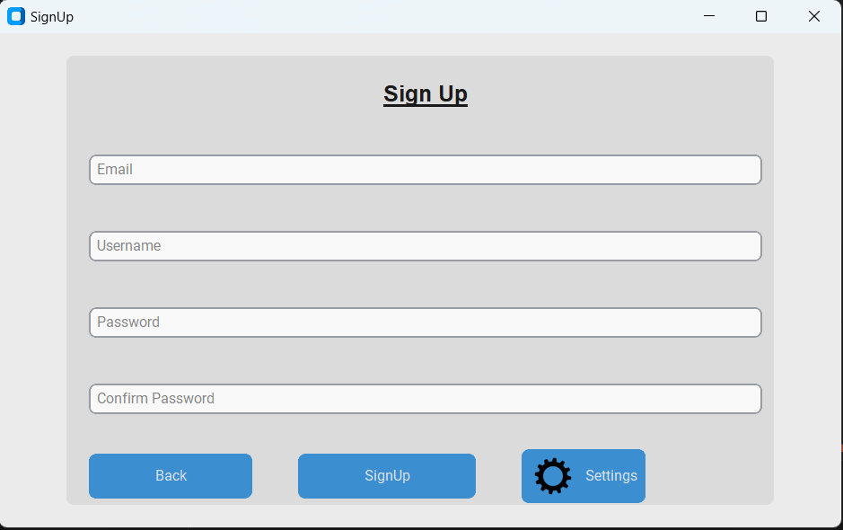
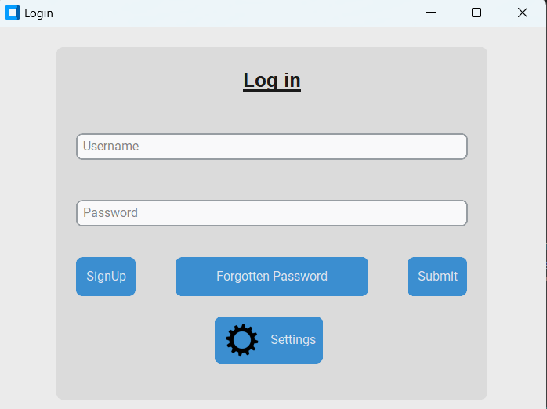
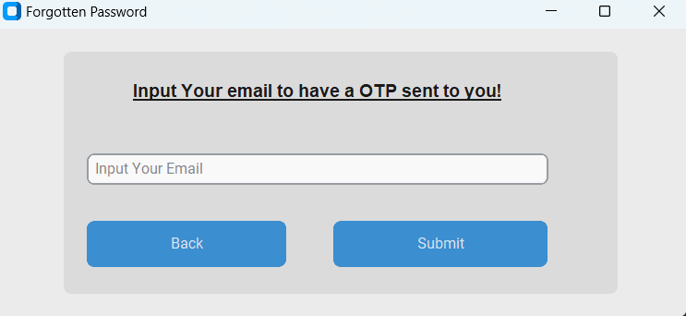
Screenshots

Slide 7
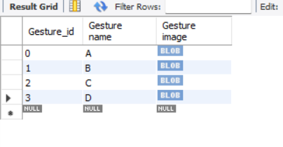
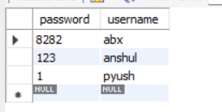
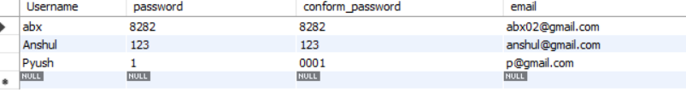
Database

Slide 8
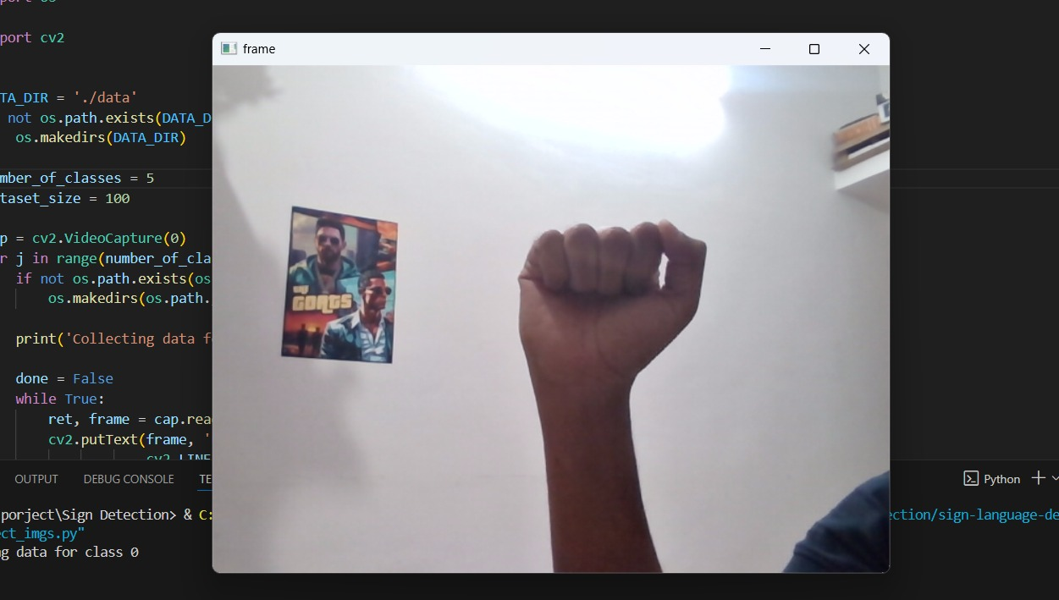
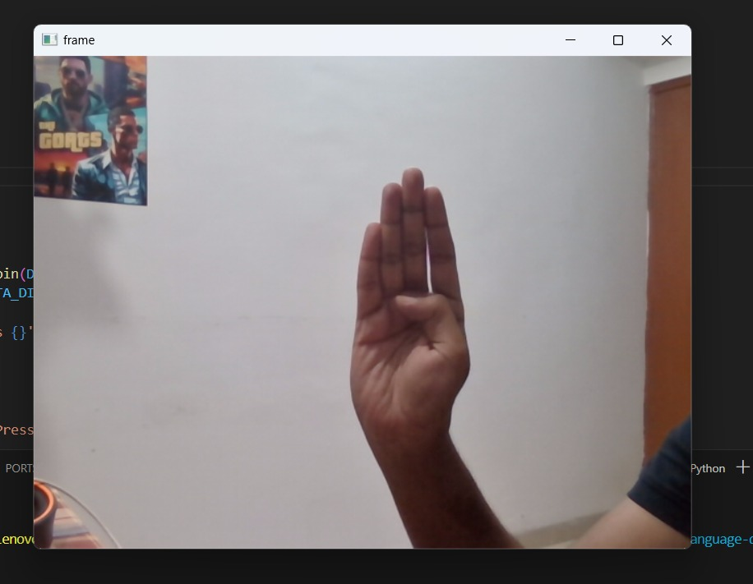
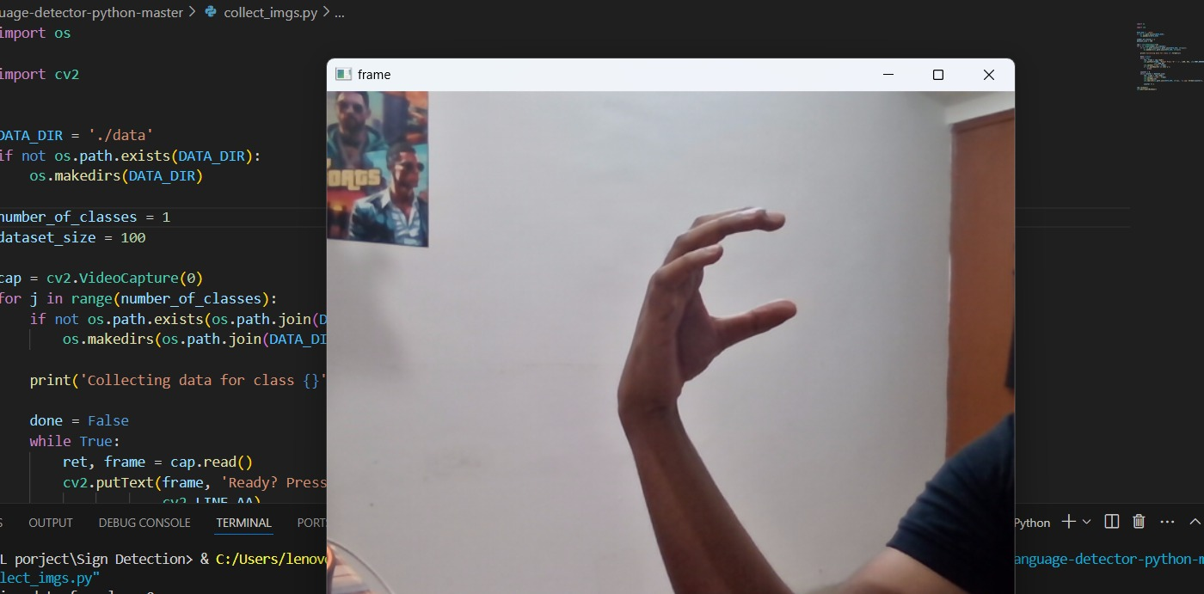
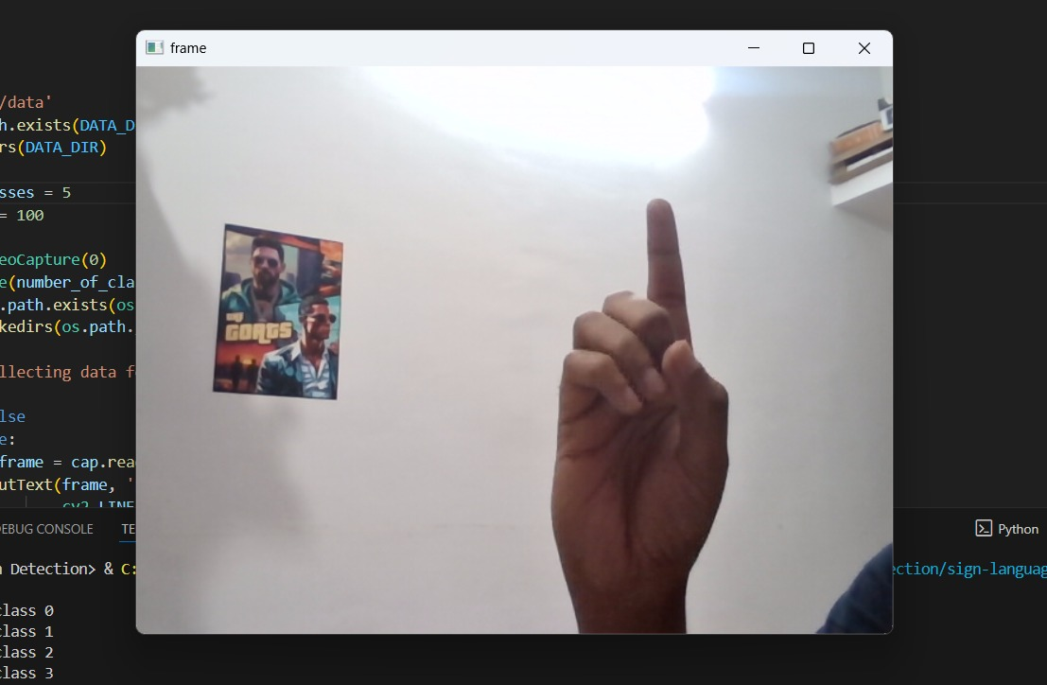
Data Training

Slide 9
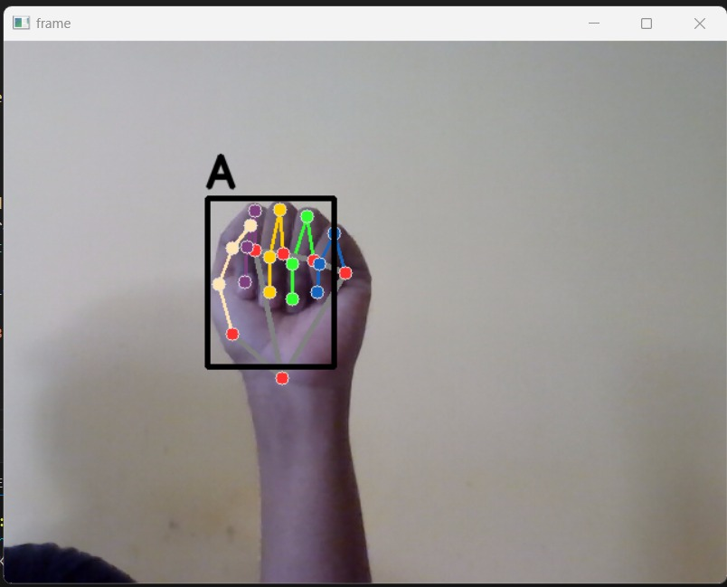
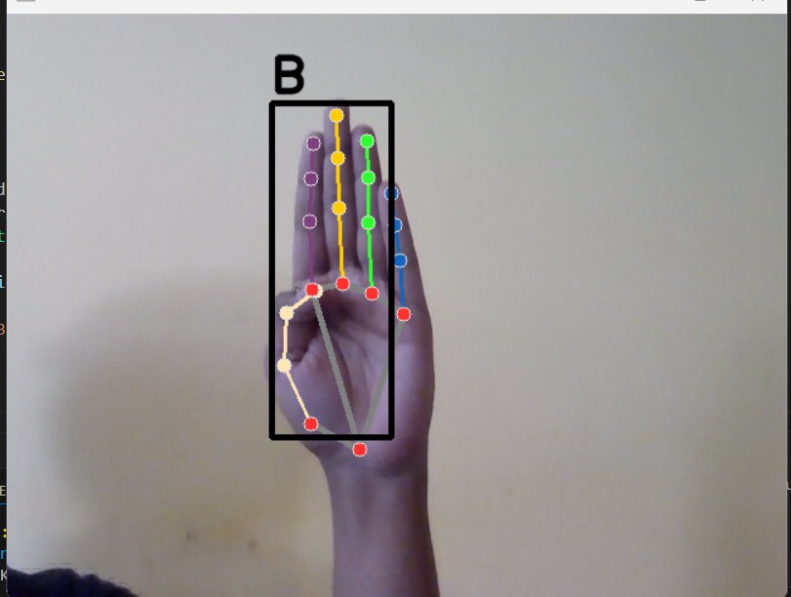
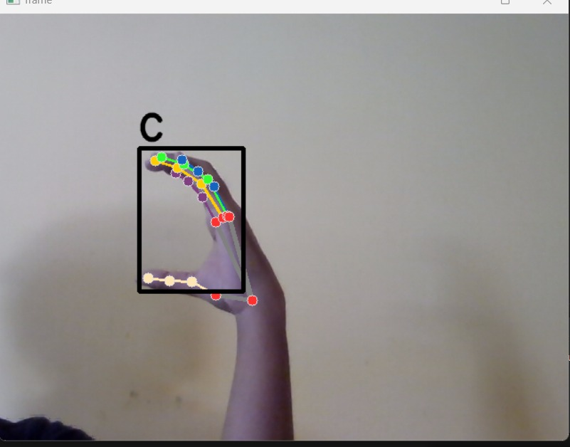
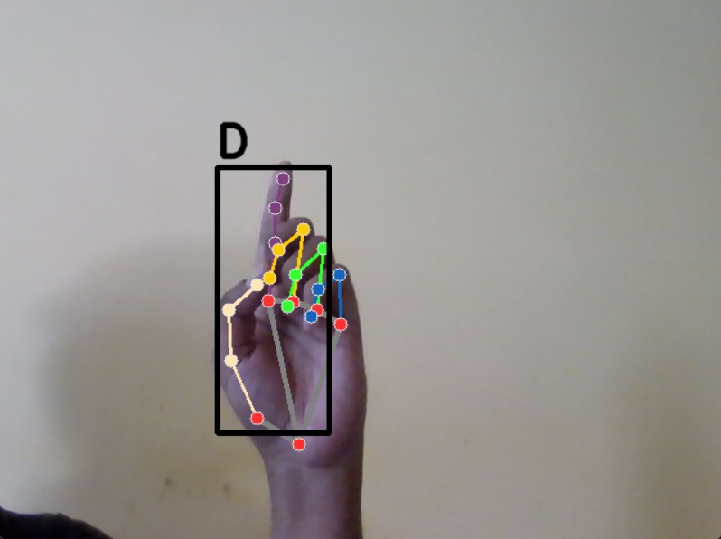
Processed output

Slide 10
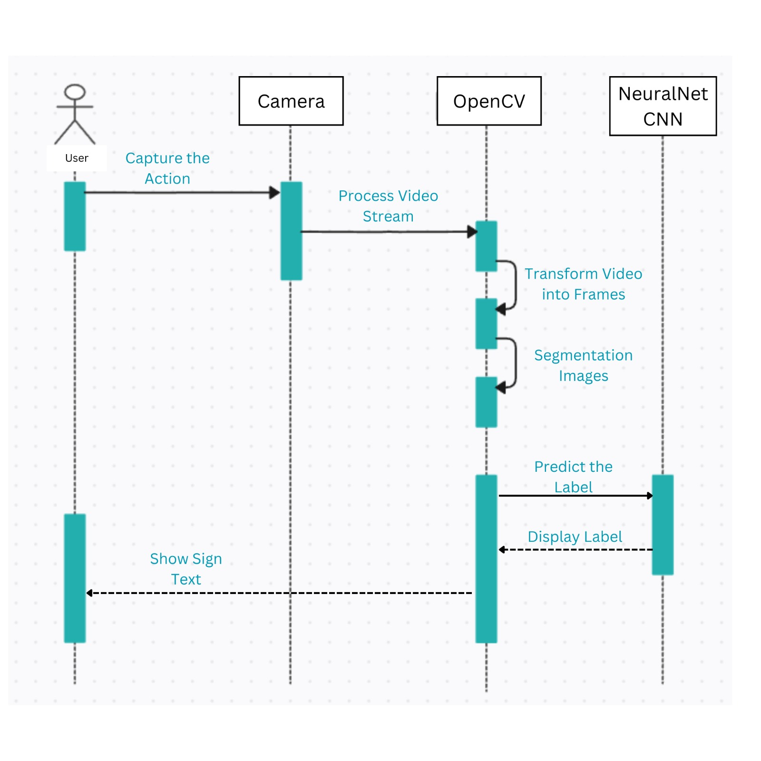
UML diagrams
Sequence diagram

Slide 11
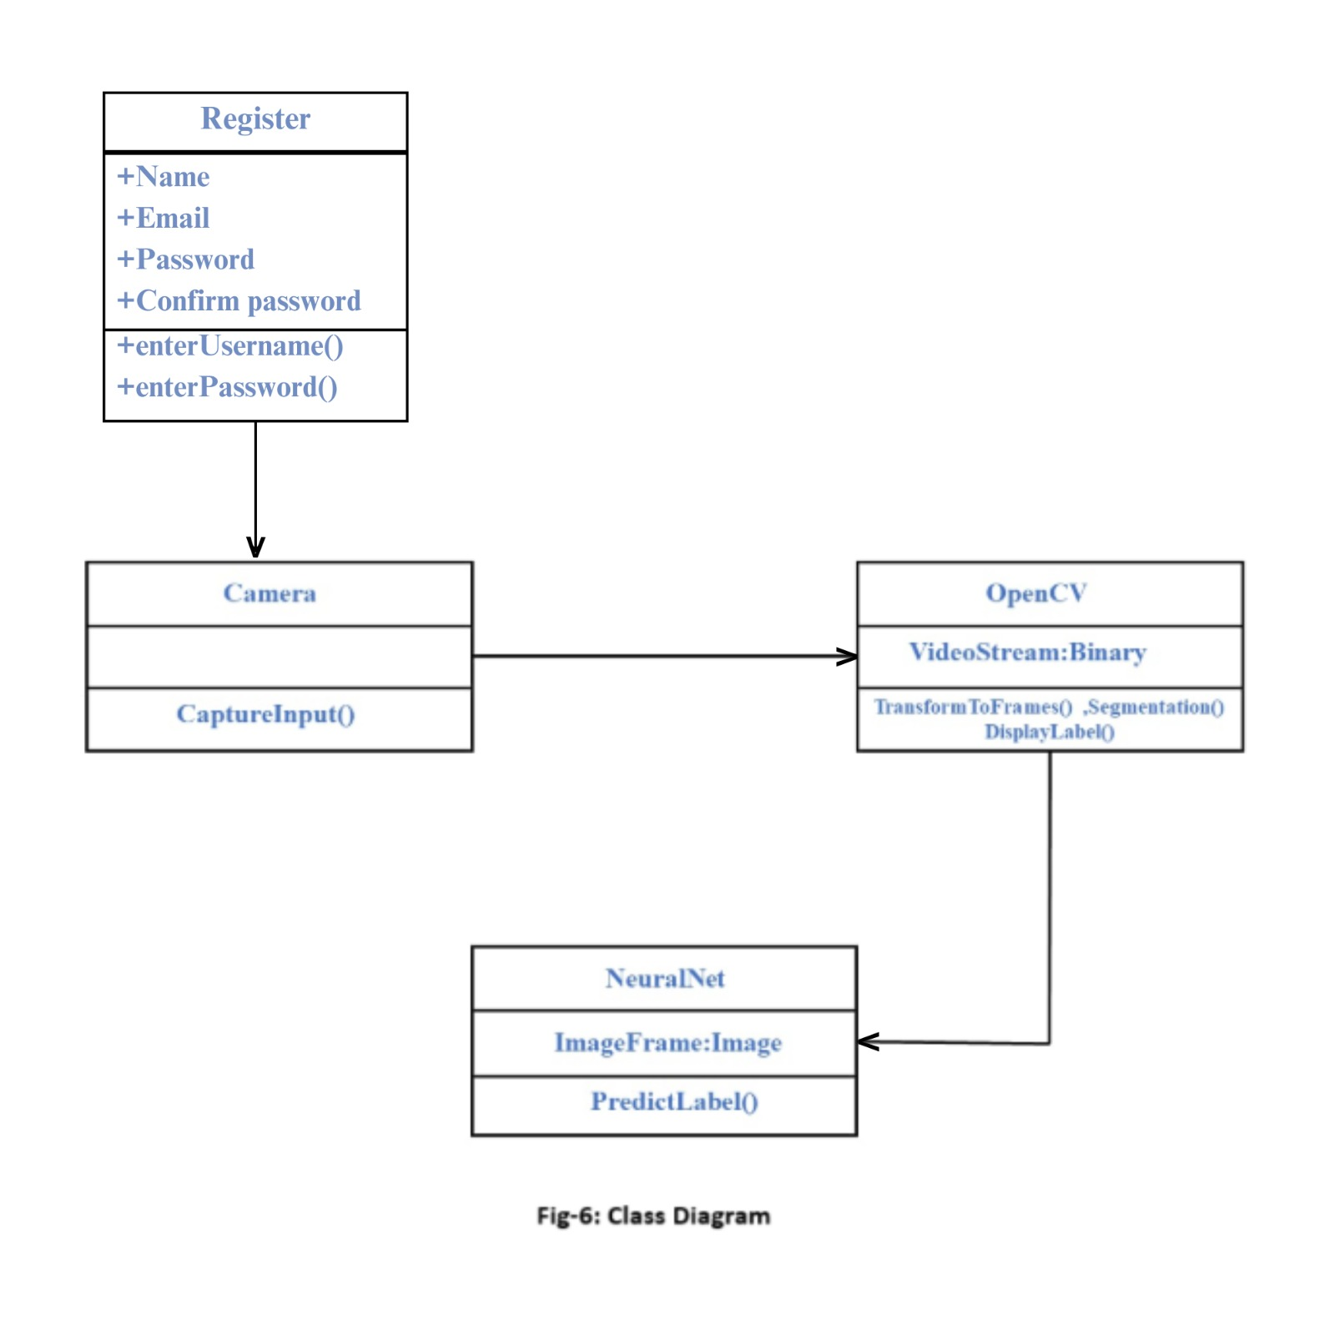
Class diagram

Slide 12
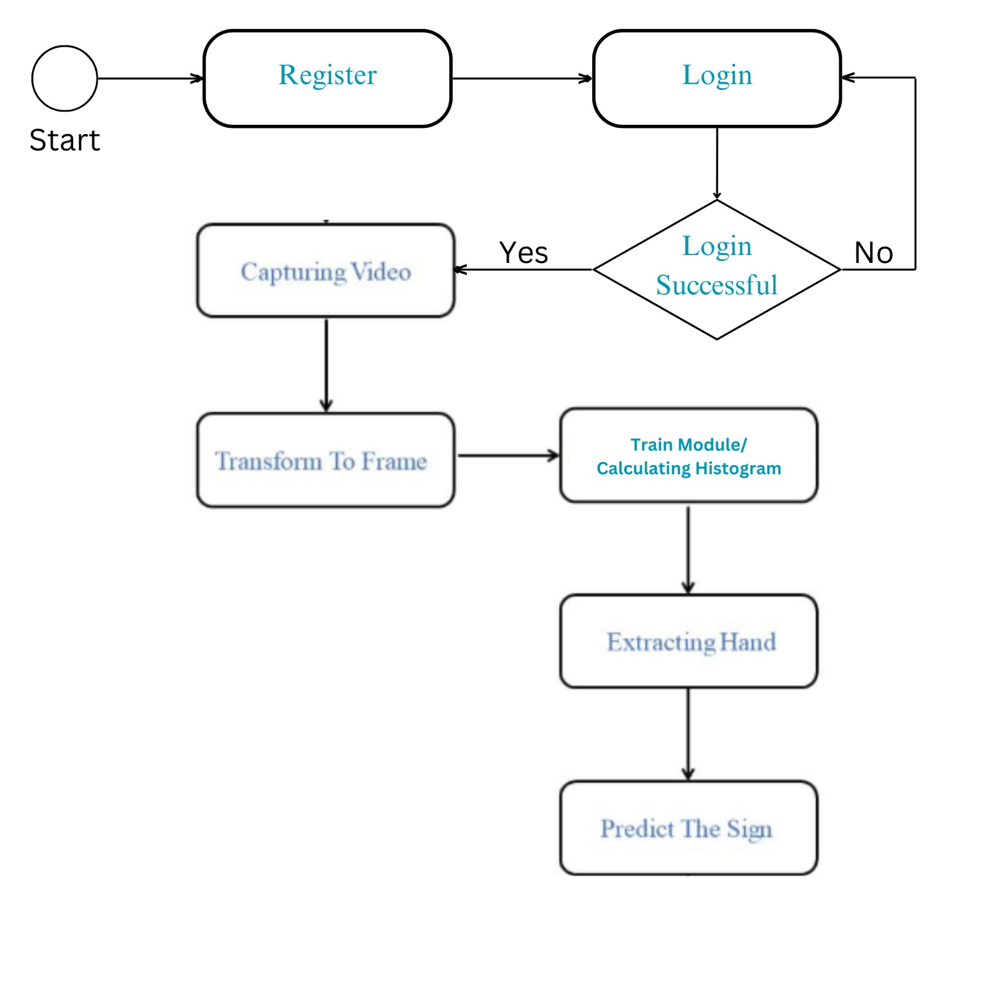
Activity Diagram

Slide 13
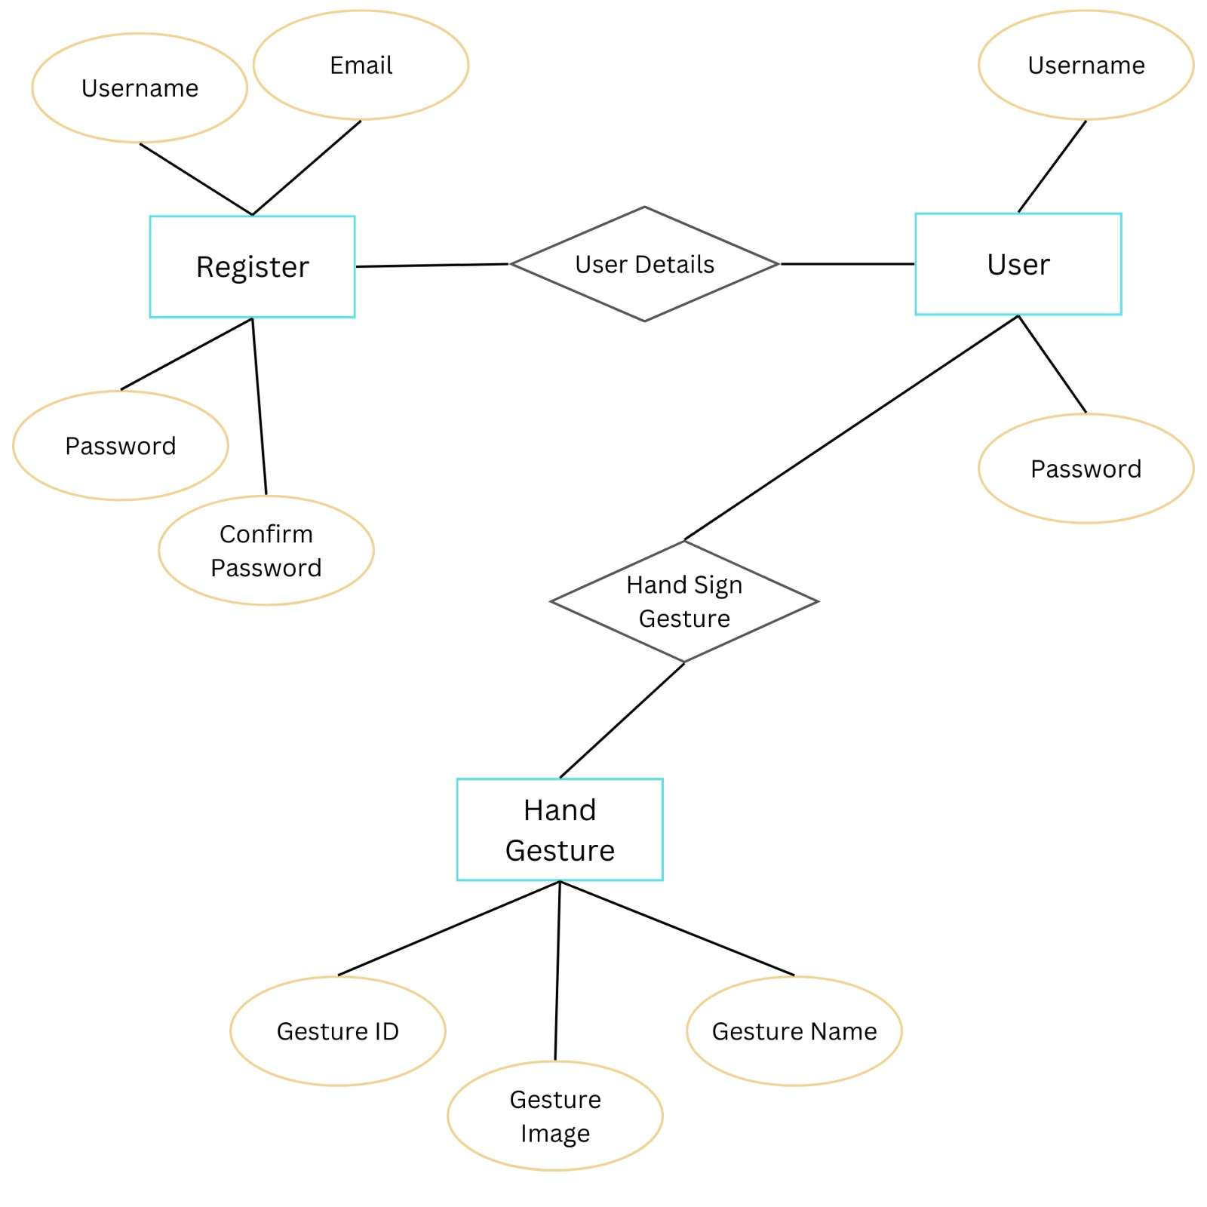
ER Diagram

Slide 14
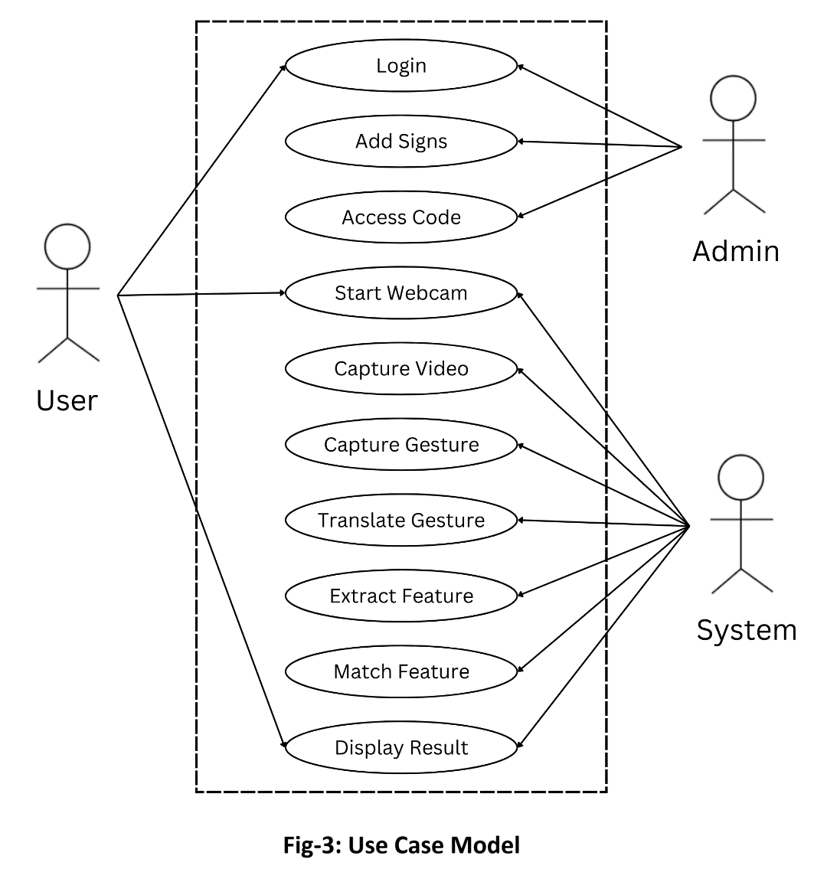
UML diagrams
Use Case

Slide 15
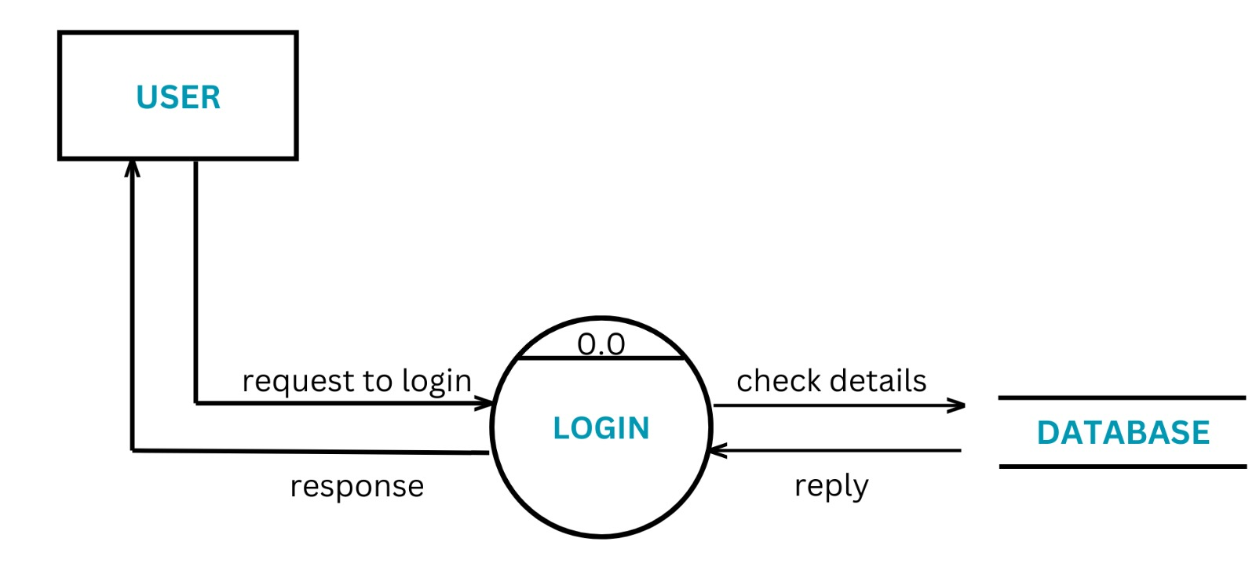
0 level Data Flow Diagram

Slide 16
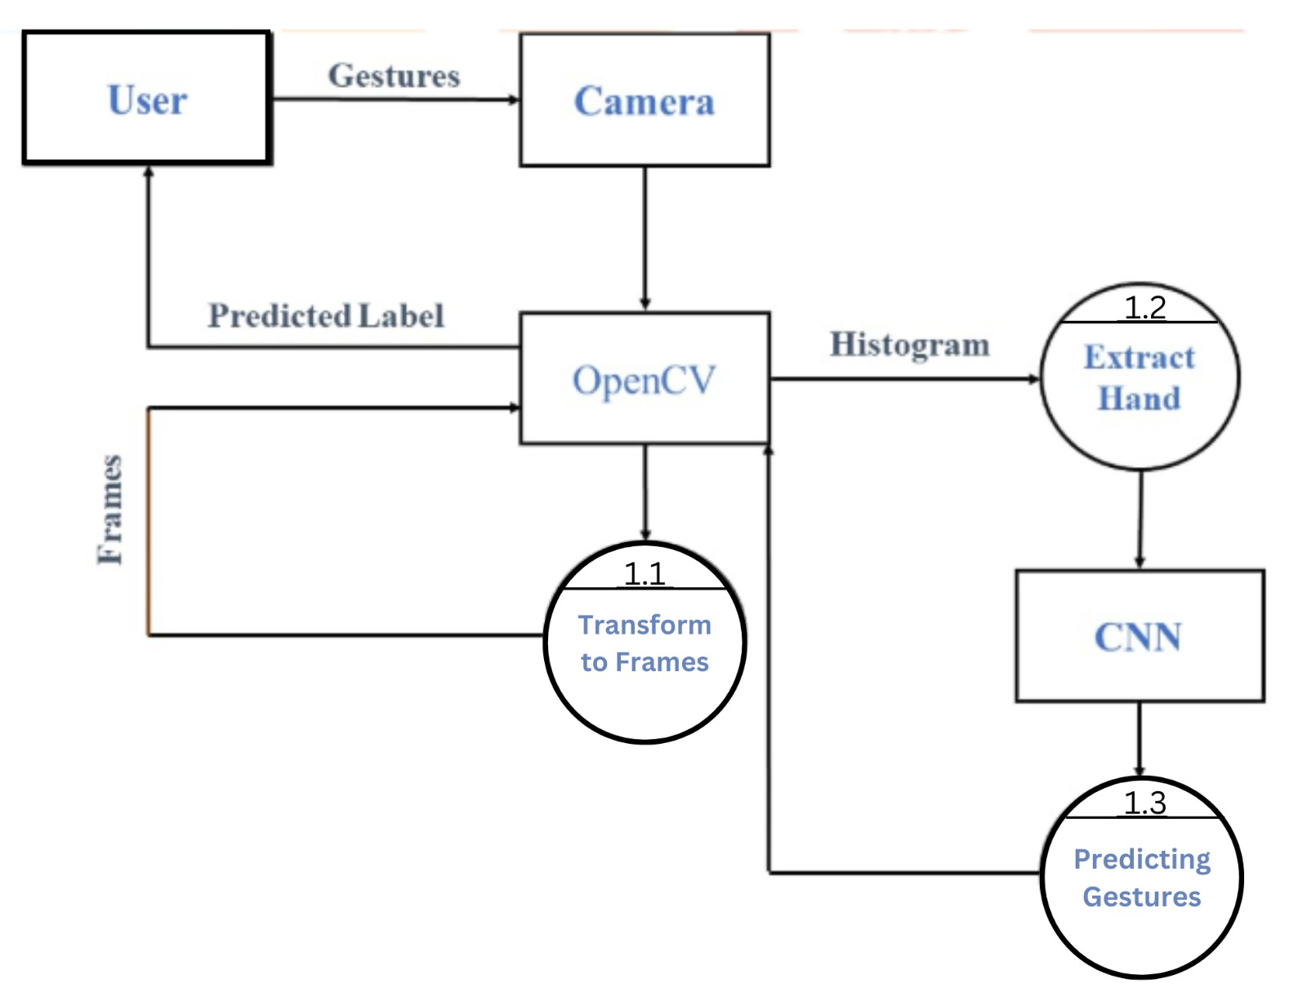
1st level Data Flow Diagram

Slide 17
Software Requirements
The prerequisites software libraries for the sign language project
• Python (Version 3.7.13)
• IDE (VS Code)
• NumPy (version 1.19.2)
• Cv2 (OpenCV) (version 3.4.2)
• Keras (version 2.3.1)
• TensorFlow (as keras uses TensorFlow in backend and for image preprocessing) (version 2.8.0)
• Media Pipe (Version 22.0.4)

Slide 18
Hardware Requirements
The Hardware Interfaces Required are:
• Camera: Good quality,3MP
• Ram: Minimum 8GB or higher
• GPU: 4GB dedicated
• Processor: Intel Pentium 4 or higher
• HDD/SSD: 10GB or higher
• Monitor: 15” or 17” color monitor
• Mouse: Scroll or Optical Mouse or Touch Pad
• Keyboard: Standard 110 keys keyboard

Slide 19
Implementation & Testing
1. Implementation Process:
Overview: it is desktop real time running application completely based on machine learning algorithms .
Technologies/Frameworks: The technologies we used is complete of python and we use different modules of python by using pip which are helpful regarding making this application
Testing :
Unit testing (code review and PyTest
Functional testing (PyTest)
performance testing (Timeit)

Slide 20
Expected Outcomes
Accurate Letter Recognition
Real time Recognition
User friendly interface
Scalability
Integration with communication devices
Accessibility

Slide 21
Conclusion
In basic terms, sign detection and letter recognition can teach machines to identify and understand simple letters like "A," "B," "C," "D," and "E." This capability can be useful for tasks such as recognizing basic symbols in educational materials. While it may seem limited, even this basic understanding can be a building block for more advanced language processing in technology..

